Slide 1

TRAFFIC SIGN RECOGNITION USING DEEP LEARNING BY NEURAL NETWORKS
SRM Institute of Science and Technology, Ramapuram Campus
DEPARTMENT OF COMPUTER SCIENCE AND ENGINEERING
Batch No: 9
DETAILS OF THE PROJECT
Kranthi Reddy RA1711003020467
Pranav Raju RA1711003020473
Thirupathi Kota RA1711003020456
SUPERVISOR DETAILS
Ms.V.Surya
Assistant Professor (O.G)
Computer Science and Engineering
SRM Institute of Science & Technology
Ramapuram Campus, Chennai

Slide 2
OBJECTIVE
The fundamental function of this system is to capture the image or video so that it can be further processed.
In fact, the camera should be properly calibrated and its dynamic range should be adjusted before capturing any scene.
The main objective of the research on TSDR is to improve the robustness and efficiency of the TSDR system.
If the cameras are placed too far away, then the image captured will be blurred and cannot be detected accurately. Hence the distance of camera from the image determines the quality of image.

Slide 3
SCOPE
In order to solve the concerns over road and transportation safety, automatic traffic sign detection and recognition (TSDR) system has been introduced.
An automatic TSDR system can detect and recognise traffic signs from and within images captured by cameras or imaging sensors.
For applying the TSDR system in real-time environment, a fast algorithm is needed. As well as dealing with these issues, a recognition system should also avoid erroneous recognition of non-signs.

Slide 4
ABSTRACT
Now a days with rapid development of society and economy, automobiles have become one of the most common modes of transportation for every individuals.
Traffic road sign detection is very crucial in transport system. The aim of the project is to detect the type of the traffic signal and act according to that.
The entire action was recorded in a video sequence by an on board camera attached to the vehicle.
The main theme of the project is for the application of driverless cars and also traffic recognition is one of the most challenging problem for driving assistance system.

Slide 5
INTRODUCTION
Traffic-sign recognition (TSR) is a technology by which a vehicle is able to recognize the traffic signs put on the road e.g. "speed limit" or "children" or "turn ahead". This is part of the feature collectively called as Advanced Driving Assistance System(ADAS).
It uses image processing techniques to detect the traffic signs.
Traffic signs give information about the road conditions ahead, provide instructions to be followed at the major crossroads or junctions, warn or guide drivers, and ensure proper functioning of road traffic.

Slide 6
Being unaware of road signs is akin to throwing caution to the wind. It can lead to loss of life and property.
For an Intelligent Transportation System Smart vehicle are must. Smart vehicles reduce number of accidents happening around the world.
An automatic TSDR system can detect and recognise traffic signs from and within images captured by cameras or imaging sensors.
A visual-based traffic sign recognition system can be implemented on the automobile with an aim of detecting and recognizing all emerging traffic signs.

Slide 7
LITERATURE SURVEY
Title : Encoding Rich Frequencies for Classification of Stroke Patients EEG Signals
Name of the Authors : Fawaz Sammani, Kok Swee Sim, and Shing Chiang Tan.
Year of Publishing : 2017
Concept and Algorithm Used : Deep Learning and, Multi-Layered Perceptron (MLP) and Decision-Trees algorithms are used.
Advantage : The model could potentially assist a medical doctor in analyzing stroke brain images with high accuracy rates. It can also be useful for rehabilitation centers to monitor the progress of stroke patients.
Drawback : The main drawback of using this EEG Signals is its Poor Spatial Resolution of Recordings.

Slide 8
Title : Traffic Sign Detection Algorithm Based on Deep Convolutional Neural Network
Name of the Authors : Xiong Changzhen, Wang Cong and Ma Weixin.
Year of Publishing : 2016
Concept and Algorithm Used : Neural Networks and deep convolutional neural network using region proposal network in Faster R-CNN.
Advantage : The experimental results show that the traffic sign detection rate of the algorithm is above 99% and the detection time is towards real-time in video sequences. It takes only about 51.5 ms average detection time for one frame with the resolution of 640h 480 video sequence. And it is robust to various interferences.
Drawback : The system doesn’t show how to obtain accurate ground truth and the class of the sign detected automatically. Also the system is not responding for a multiple set of images in a single frame.

Slide 9
Title : Traffic Sign Detection and Pattern Recognition using Support Vector Machine
Name of the Authors : Kiran C.G, V. Prabhu, Abdu Rahiman V. and Rajeev K.
Year of Publishing : 2009
Concept and Algorithm Used : Machine Learning and Support Vector Machines algorithms are used.
Advantage : The system uses colour segmentation, shape classification and pattern recognition and produces an output of 75.19% achieve in signal and sign recognition. The main advantage is response time is of 64.2 ms.
Drawback : The system has certain drawbacks that its achievement rate is less and misses recognition of certain signs when it is left for real-time scenario. Also the hue saturations cause delay in recognition of data.

Slide 10
Title : Detection and Recognition of Traffic Signs based on RGB to Red Conversion.
Name of the Authors : Mr.Mohith Bhairav Mahatme, Mrs.Sonia Kuwelkar.
Year of Publishing : 2017
Concept and Algorithm Used : Image Processing and Single Layer Perception algorithm.
Advantage : The system has an accuracy of 93.25% in detection and recognition of traffic signs.
Drawback : It uses HSV colour segmentation process(Hue-Saturation-Value).In case of outdoor Images ,the colour is sensitive to variation in lightening. Hue becomes meaningless. So, it becomes hard for the light colour to find out.

Slide 11
EXISTING SYSTEM
The system is based on neural networks in which it uses a image processing followed by deep neural network algorithms.
The main Part of the system is that it uses a multi level layers of neural networks for data recognition to show an output in a clear crystal manner with an accuracy of precision of 97%.
The system has a support of high definition camera and the distance between the object and the camera is adjusted so that a clear cut is captured every time in real scenario.
The system also supports multiple set of images in a single frame when images are passed on by 45fps.

Slide 12
PROPOSED SYSTEM
The fundamental function of Proposed system is to capture the image or video so that it can be further processed.
The position and resolution of cameras acquiring the images of signs are the main concern.
The traffic sign detected in the image is small and noisy if captured with a low resolution camera and the image would not be detected efficiently.
In this system we use TensorFlow and Python as our software requirements for implementing deep learning algorithms on training the data and testing it by the convolutional layers of neural networks.

Slide 13
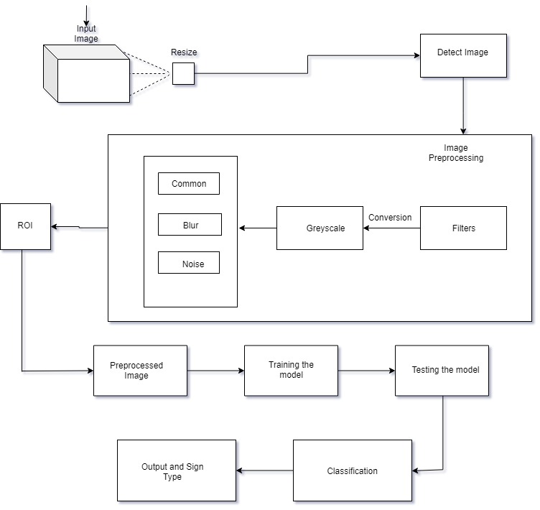
ARCHITECTURE DIAGRAM

Slide 14
MODULES
Prepare a Dataset of images
-Training set
Image Pre processing
Network Structure
-Convolution
-Normalization
-Pooling
-Output Layer
Testing and Recognition

Slide 15
Training Dataset
The German Traffic sign Benchmarks dataset used for the training of the model.
The GTSRB dataset was divided in to training set and testing set of which the training set has a 4167 images for training of model and for testing and validation of the model the paper uses a 1994 images to get a desired output.
The images are of 1236*968 pixels with a measured ground truth value.
The training and testing datasets may have different set of images. One with an uneven color while the other with sign tilt or distortion of color etc., These images are sent as an input to the model for detection and classification of traffic signs.

Slide 16
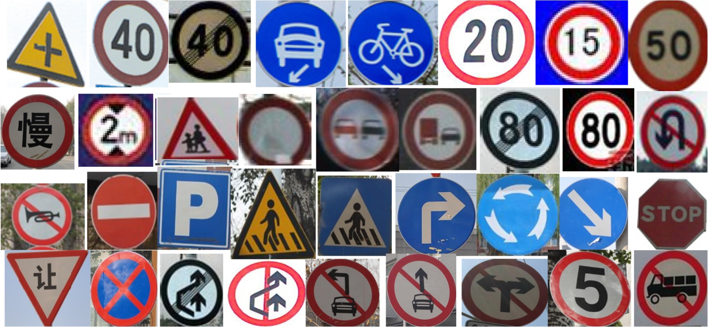
GTSRB Dataset of Images

Slide 17
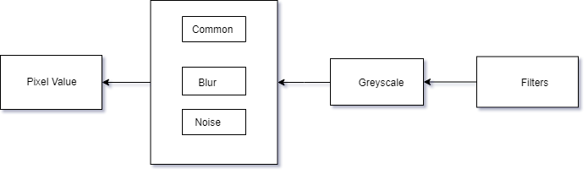
Image Pre-Processing
Steps involve are
Filters
Greyscale Conversion
Matrix conversion

Slide 18
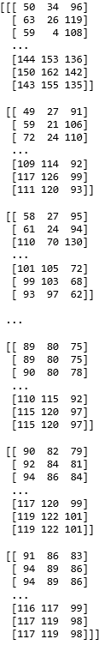
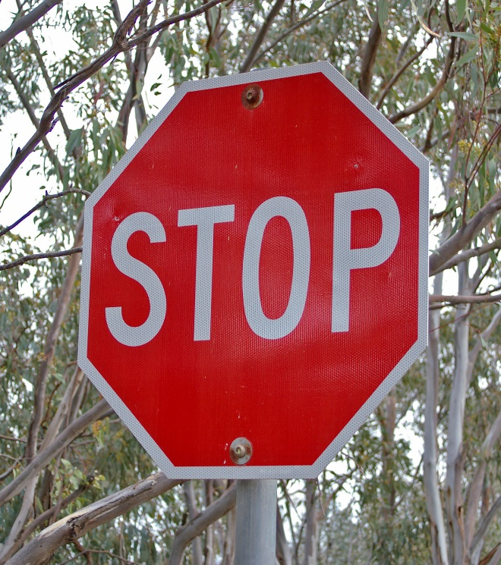
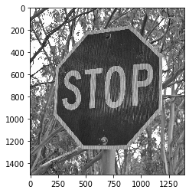
RGB Greyscale PIXEL

Slide 19
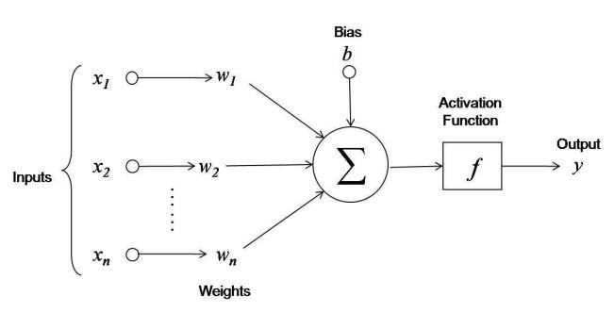
Network Structure
Convolution:
Each neuron receives several inputs, takes a weighted sum over them and forms a feature map called a bias function.

Slide 20
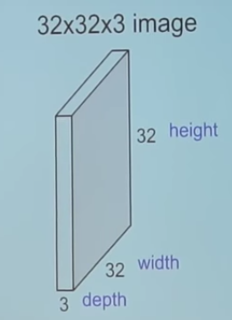
Convolution:
A 3 convolution layers with 2*2 max pooling was used for training the model.
3d matrix form of single convolution layer is as shown.

Slide 21
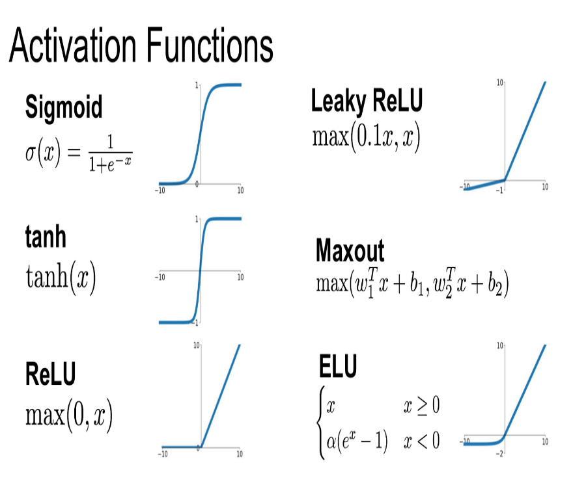
Normalization
RELU layer will apply an elementwise activation function, such as the max(0,x) thresholding at zero. This leaves the size of the volume unchanged ([32x32x12]).
Rectified Linear Unit.

Slide 22
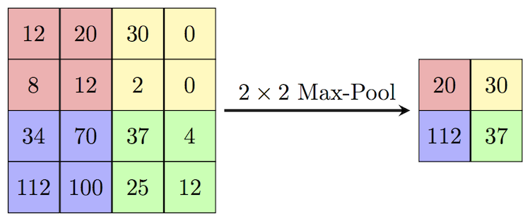
POOLING
Max pooling is a technique used to reduce the dimensions of an image by considering the maximum amount of pixel value in the grid. Max pooling helps to reduce over fitting and makes the model to look more generic.

Slide 23
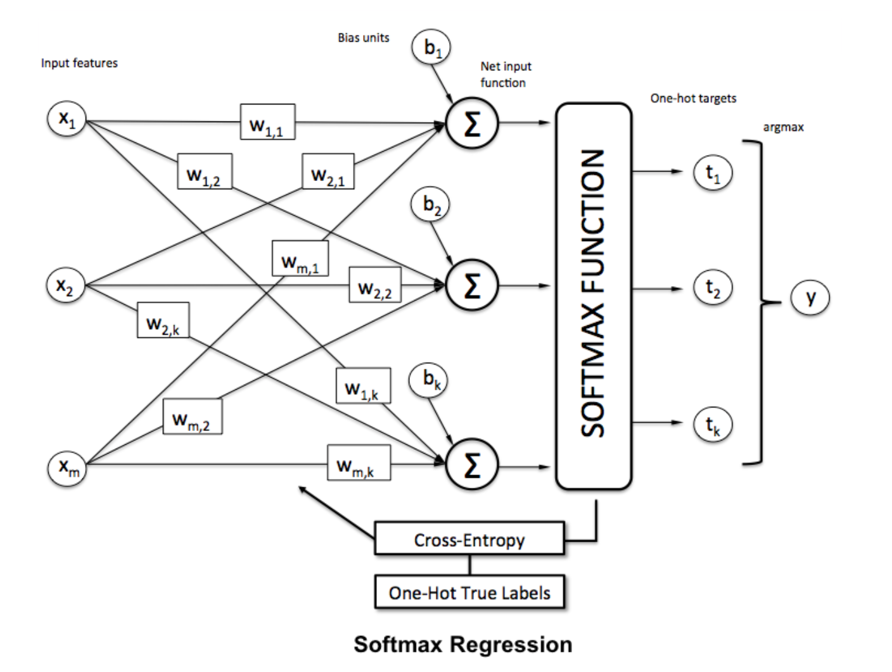
Output layer

Slide 24
A SoftMax function is a type of squashing function. Squashing functions limit the output of the function into the range 0 to 1.
This allows the output to be interpreted directly as a probability.
Since the outputs of a SoftMax function can be interpreted as a probability (i.e. they must sum to 1), a SoftMax layer is typically the final layer used in neural network functions.

Slide 25
Testing the dataset
Several adjustments were made for training the data. The paper uses a batch size of 32 since the images were around from 2000-3000.
The training set uses epoch of 40. After iteration of 20,000 times, the precision accuracy was found to be 96%.
Batch size of 32 and epoch of 20 /50 are used for testing set.
The model is capable of recognizing the images with an accuracy of 97% for an epoch value of 50. For increase in epoch value can produce accuracy rate of 98%, but time complexity of algorithm increases.

Slide 26
Output
The output obtained is found to be accurate with a precision rate of 97%.
The system also detects the low light images and recognises in obtaining the pattern of the output with an accuracy of 94%.
The accuracy test results indicate that the transfer learning-based method(neural networks) is powerful for traffic sign recognition is better efficient and finite.

Slide 27
Results
The accuracy rate was found to be accurate but with a minute difference of 2-3 %.The proposed system gives an accuracy rate of 97% in real time scenario of detection and recognition.
Addition of more amount of data to the training data set would help in accurate decision for traffic sign , for example some traffic signs may have high color contrast, dimming of colors due to sunshade can result an error in detection or fakes a longer time for detection.

Slide 28
CONCLUSION
Aiming at the problem of traffic sign detection and recognition, this paper presents a traffic sign detection and recognition method based on image-processing and deep neural networks .
Comparisons of each stage by training and validating the dataset makes our model good fit and helps in the output prediction .
As a whole, this method can reach the need of real time and accuracy for the detection and recognition of traffic sign .

Slide 29
REFERENCES
Encoding Rich Frequencies for Classification of Stroke Patients EEG Signals. Authors: Fawaz Sammani, Kok Swee Sim , and Shing Chiang Tan.
Traffic Sign Detection Algorithm Based on Deep Convolutional Neural Network. Authors: Xiong Changzhen, Wang Cong, Ma Weixin, Shan Yanmei.
Traffic Sign Detection and Pattern Recognition using Support Vector Machine. Authors: Kiran C.G, Lekhesh V. Prabhu, Abdu Rahiman V and Rajeev K.
Detection and Recognition of Traffic Signs based on RGB to Red Conversion. Authors: Mr . Mohith Bhairav Mahatme, Mrs . Sonia Kuwelkar.

